Slide 1
IST 659: Organ Procurement and Transplantation Network System
By :-
Abhijeet Kumar
Dev Jindani
Megha tyagi
Project group 10 Prof. michael fudge

Slide 2
Overview
The organ procurement and transplantation network system (OPTNS) is a database management system that creates, manages, and works with different kinds of data about a person's donation or procurement of a specific organ.
Every person in the database has a thorough medical history as well as other vital details like blood group, age, and so forth.
In today's complicated healthcare environment, this record serves a number of purposes and is essential for the successful operation of the organ procurement and transplantation network system.
It essentially maintains a database of statistical data regarding the network of organ donation and procurement.

Slide 3



Technologies Used

Slide 4
GOALS
To create an organ procurement and transplantation network system using Microsoft SQL server, Azure data studio and Microsoft power applications.
The system consists of a database management tier and an organization tier.
The doctor's data is visible.
There is a log table in place.
Data of both patients and donors can be accessed.
To provide statistical information regarding the number of organs needed and available at the particular point of time. To plan, evaluate, and coordinate organ donation and procurement.

Slide 5
Specifications
Entity relationship data requirements/business rules
Conceptual data model
Logical data model
Logical design user interface layout
Demo of UI and layout
Table data

Slide 6
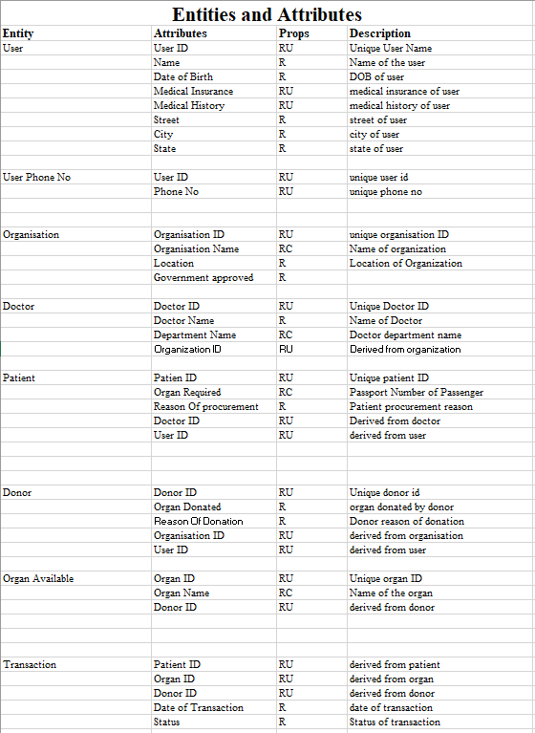
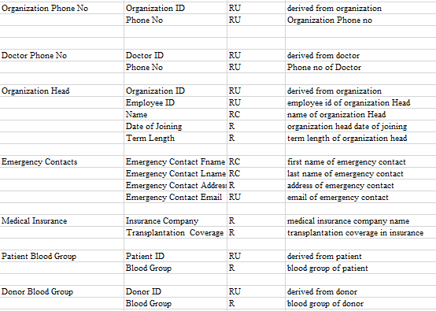
ERD Data Requirements

Slide 7
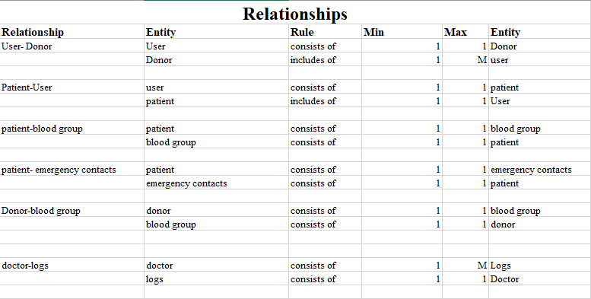
ERD Data Requirements

Slide 8
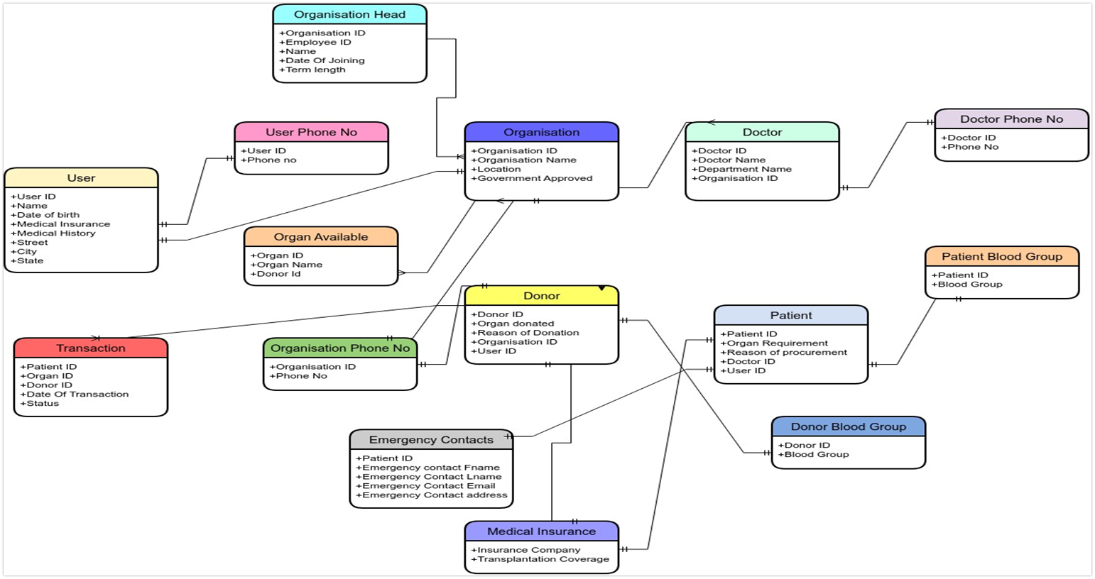
Conceptual Model

Slide 9
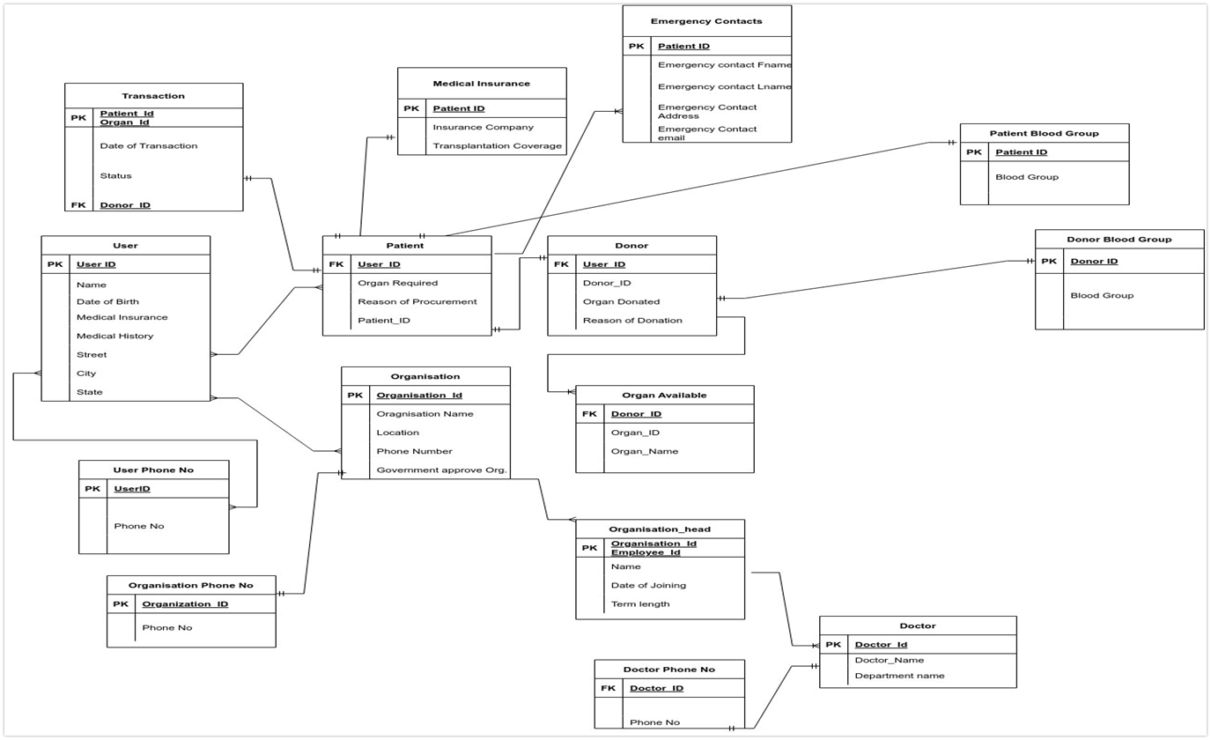
Logical Model

Slide 10
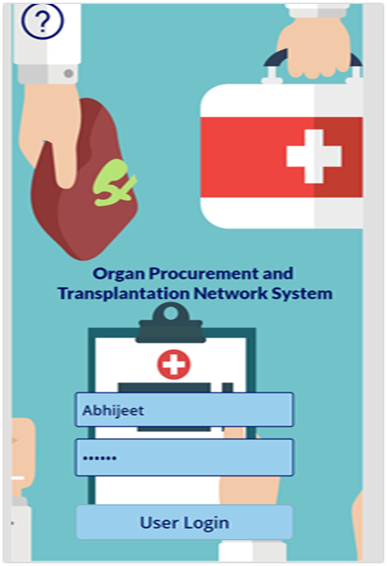
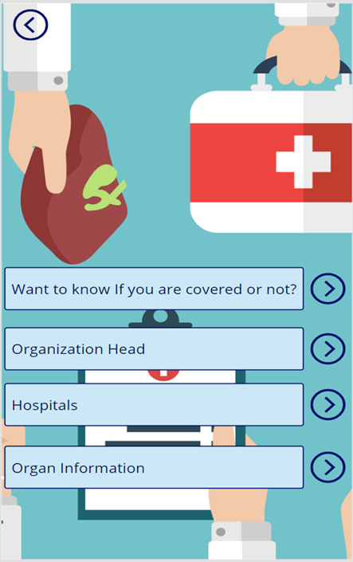
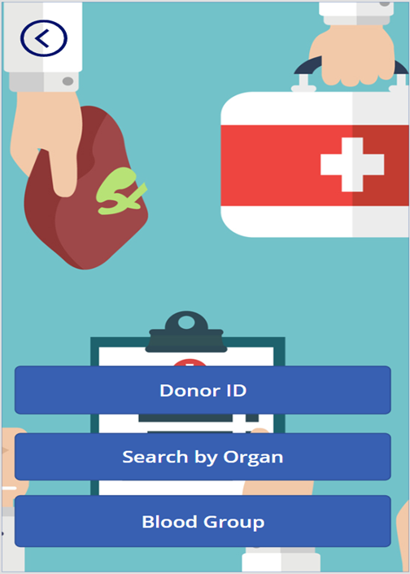
Demo of UI and Layout

Slide 11
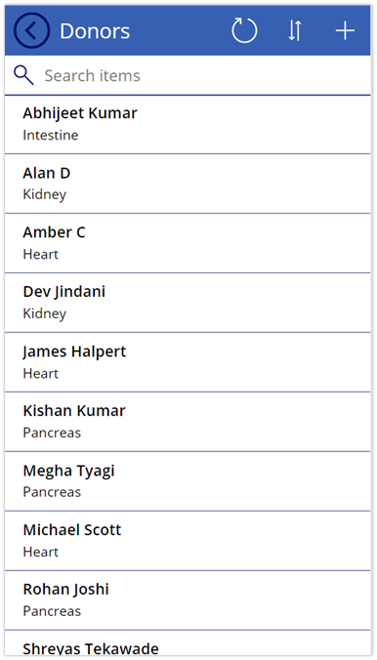
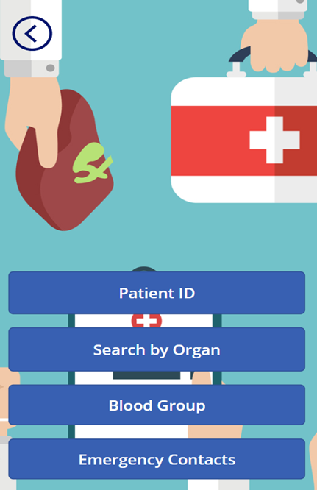
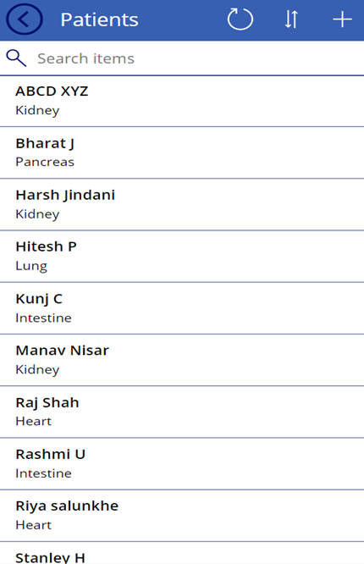
Demo of UI and Layout

Slide 12
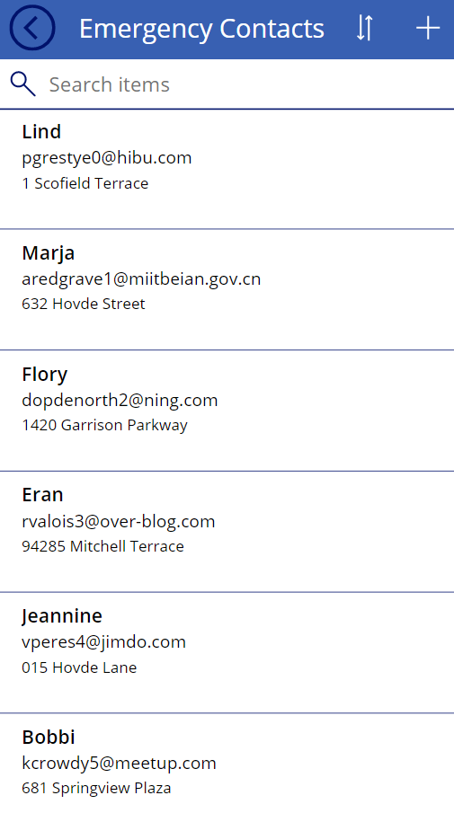
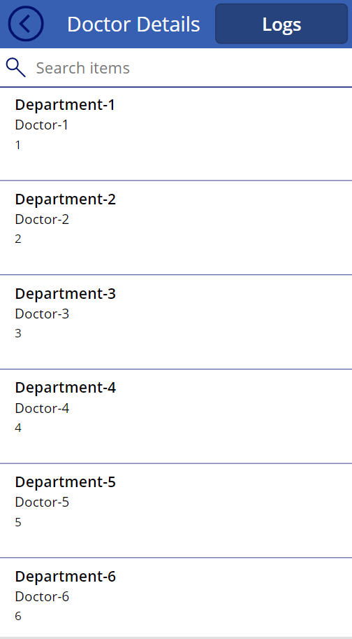
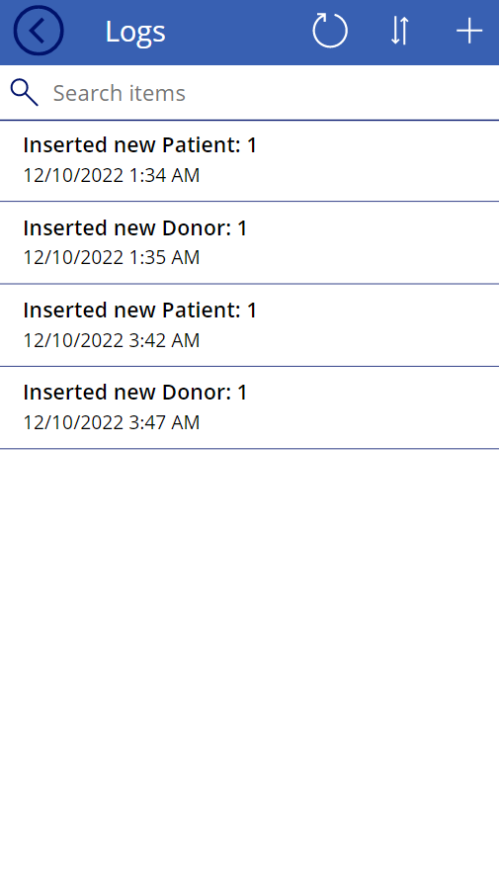
Demo of UI and Layout

Slide 13
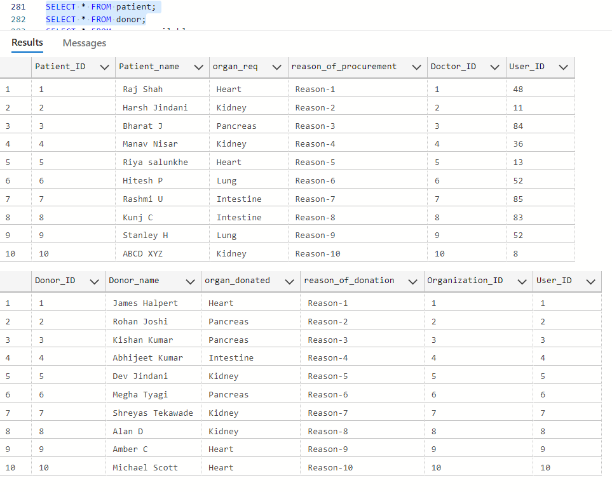
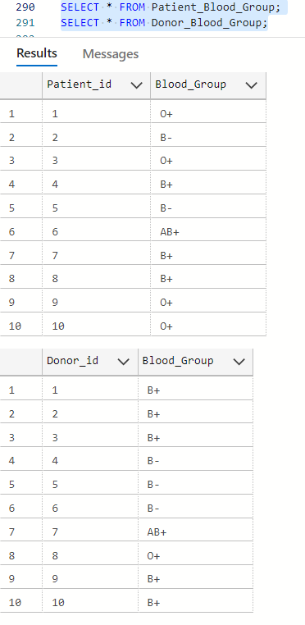
Table Data

Slide 14
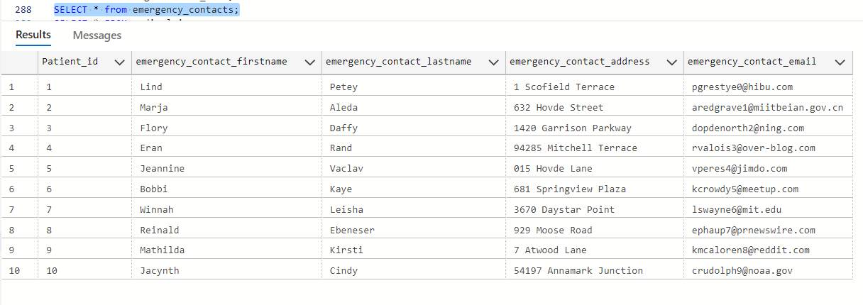
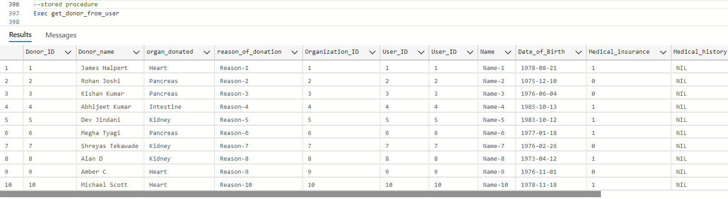
Table Data

Slide 15
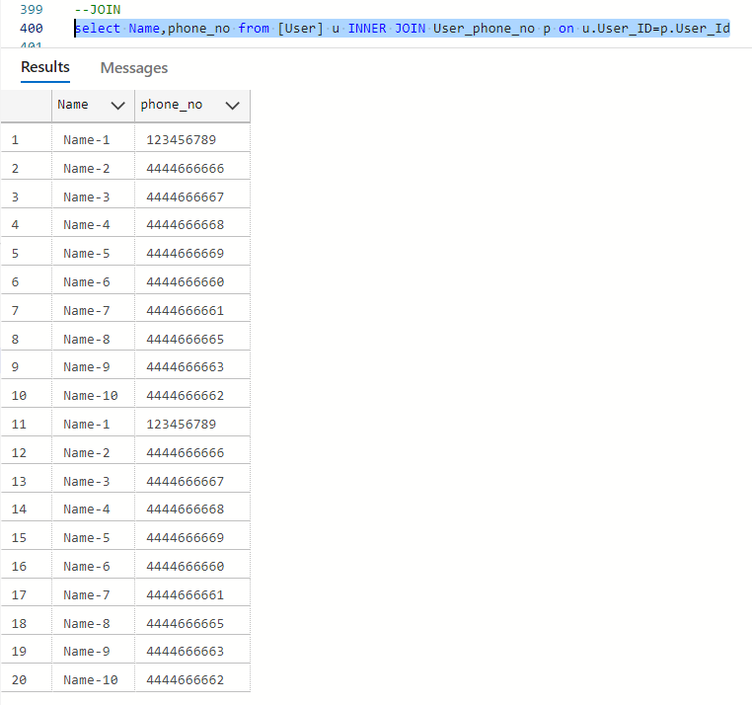
Table Data

Slide 16
Conclusion
In today's complicated healthcare environment, this record serves a number of purposes and is essential for the successful operation of the organ procurement and transplantation network system.
These records show statistical data on how many organs are needed and how many are available at any particular time. It is necessary for the coordination, evaluation, and planning of organ procurement and transplantation.
The system interfaces were created to satisfy the demands and needs of the market at the time.
This system will help with issue solving and enhancing performance in the present.

Slide 17
Thank You

